Slide 1
Simulation & Modeling 2018-2019
LAB 3

Slide 2
Course Regulations
1. Number of Team Members: Minimum 3, Maximum 6.
2. Each team member should attend the delivery at least once (UI development is not considered).
3. Submit your email in contacts form for receiving announcements.
4. Materials will be uploaded weekly on dropbox.

Slide 3
Links
1. Dropbox: https://www.dropbox.com/sh/4vaectqus7ygrkl/AACAUqWwhFZYH_pggTWwWbWja?dl=0
2. Contacts Form:
Credit: https://docs.google.com/forms/d/1TT8KW-5PVjuWqk0ifHBxCdfKv_vOlFWSdtYRdVLFjT8/edit
General: https://docs.google.com/forms/d/1z90g9ZFf53DQtbWHsnB13aKgWgTBO80ZJPOnkMYZogs/edit
3. Teams Registration Form:
Credit: https://docs.google.com/forms/d/e/1FAIpQLSdznsqSQ8Cq36mkqVS-kKgeHfVLmqR2WUXU7eX4lvvOyYdkZQ/viewform
General: https://docs.google.com/forms/d/e/1FAIpQLScSVk3wS-ES5HxgUuyw5GvS9eJOZiJdgPglNjUiLKjg7f-4QA/viewform

Slide 4
TA Contacts
Name | Email
Eman Assem | eman_cisasu@yahoo.com
Reham Ahmed | rehamahmed@cis.asu.edu.eg
Sarah Osama | sarah.osama@cis.asu.edu.eg
Hadeer El-Saadawy | hadeer.elsaadawy@gmail.com

Slide 5
Multi-channel Queue
THE CALL CENTER

Slide 6


Multi-channel Queue
Baker
Able

Slide 7

Multi-channel Queue

Slide 8
Multi-channel Queue
Baker
Able

Slide 9
Multi-channel Queue

Slide 10

Multi-channel Queue
Baker
Able

Slide 11
Multi-channel Queue

Slide 12
Multi-channel Queue
Baker
Able

Slide 13
Multi-channel Queue - Arrival of a Customer
Arrival Event
Is Able Idle?
Yes
Customer enters service
No
Customer enters queue for service
No
Is Baker Idle?
Yes
Customer enters service
Unit-entering-system flow diagram

Slide 14
Multi-channel Queue - Departure of a Customer
Departure Event
Begin server idle time
No
Another customer waiting?
Yes
Remove the waiting customer from the queue
Begin servicing the customer
Service-just-completed flow diagram

Slide 15
Multi-channel Queue
We need to the system measures of system performance in terms of:
The efficiency of Able.
The efficiency of Baker
The average caller delay.

Slide 16
Multi-channel Queue - System Design
Server Selection: [How to select a server when both servers are available?]
Highest Priority
Each server should be assigned a priority
When a customer arrives, it enters the available server having the highest priority
Random
Choose any server of the available servers
Least utilization [Bonus]
When a customer arrives, calculate the utilization of the available servers
The customer enters the server having the least utilization, i.e. the server that worked the least amount of time since the system has started running.

Slide 17
Multi-channel Queue - System Design
System Variables
Arrival Time(i) = T_{i}
Interarrival Time(i) = A_{i} = T_{i} – T_{i-1}
Service time(i) = S_{i}
Waiting Time(i) = D_{i}
Departure Time (i) = C_{i} = T_{i} + D_{i} + S_{i}
S and A are stochastic variables (generated according to probability distribution)

Slide 18
Multi-channel Queue - System Input
Inter-arrival time distribution
Number of servers
Service time distribution for each server
Server Selection method (priority, random, least utilization[BONUS])
Stopping Condition
Maximum Number of customers
Simulation end time

Slide 19
Multi-channel Queue - System Output
Results table including these columns:
Customer No
Random Digit for inter-arrival time
Inter-arrival time
Arrival time (Clock Time)
Random Digit for service duration
Service duration
Server Index
Time Service Begins
Time Service Ends (Departure)
total delay time for this customer (Time in queue)
N.B: Assume Server 1 has higher priority

Slide 20
Sample Testcase

Slide 21
Multi-channel Queue - Sample Input
Interarrival Distribution of calls
Interarrival Time | Probability | Cumulative probability | Rang
1 | 0.25 | 0.25 | 01-25
2 | 0.40 | 0.65 | 26-65
3 | 0.20 | 0.85 | 66-85
4 | 0.15 | 1 | 86-00

Slide 22
Multi-channel Queue - Sample Input
Able’s Service Time distribution
Service Time | Probability | Cumulative probability | Range
2 | 0.30 | 0.30 | 1-30
3 | 0.28 | 0.58 | 31-58
4 | 0.25 | 0.83 | 59-83
5 | 0.17 | 1 | 84-00

Slide 23
Multi-channel Queue - Sample Input
Baker’s Service Time distribution
Service Time | Probability | Cumulative probability | Range
3 | 0.35 | 0.35 | 1-35
4 | 0.25 | 0.60 | 36-60
5 | 0.20 | 0.80 | 61-80
6 | 0.20 | 1 | 81-00

Slide 24
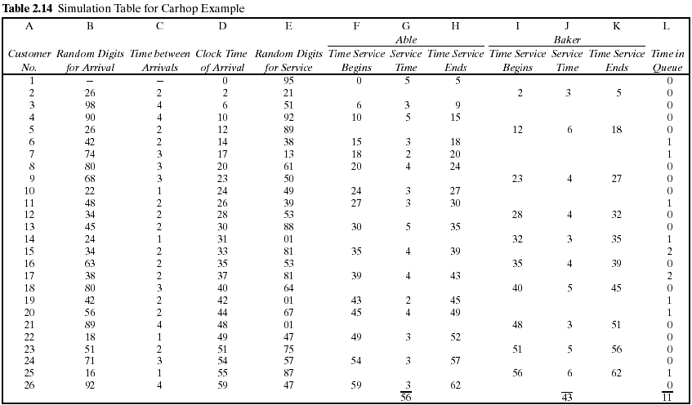
Multi-channel Queue - Sample Output

Slide 25
System Output - Performance Measures
Calculate the Measures of Performance for the system:
Average waiting time (in the queue).
Maximum queue length.
Probability that a customer wait in the queue.
Per Server:
Average service time per server.
Utilization of each server
Probability that a server is in idle state.
Do we need extra server? Why?!!

Slide 26
System Output - Performance Measures
Measure system performance by calculating the following variables:
Maximum queue length during simulation runtime.
Notes:
Total number of customers : number of customers that have entered the server
Total time customers waited in queue : the sum of delay time of the customers that entered the server
Number of customers who waited: number of customers that have entered the server and having delay time > 0

Slide 27
System Output - Performance Measures Per Server
Measure servers performance by calculating the following variables:
Notes:
Total number of customers : number of customers that have entered the server
Total time customers waited in queue : the sum of delay time of the customers that entered the server
Number of customers who waited: number of customers that have entered the server and having delay time > 0

Slide 28
Multi-channel Queue – Graph
Required Chart
Server Busy Time [One for every server]
X-axis : time
Y- axis : it has a value of 1 if the server is busy or zero if the server is idle

Slide 29
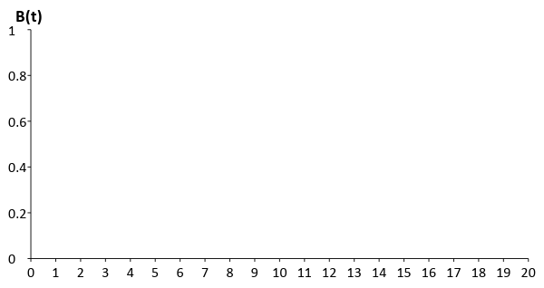
Server Busy Time – Server 1

Slide 30
Server Busy Time – Server 2

Slide 31
Task (1) Deliverables
The complete simulation table for 100 customers (refer to slide 24)
The performance parameters calculated from the simulation table (refer from slide 25 to 28)
The graph (refer from slide 28 to 30)

Slide 32
More Notes
GUI is mandatory.
Well OOP design is mandatory.
Bonus: reading input data from file.

Slide 33
Template Walkthrough

Slide 34
Multi-channel Queue - Sample Input
Interarrival Distribution of calls
Interarrival Time | Probability | Cumulative probability | Rang
1 | 0.25 | 0.25 | 01-25
2 | 0.40 | 0.65 | 26-65
3 | 0.20 | 0.85 | 66-85
4 | 0.15 | 1 | 86-00

Slide 35
Multi-channel Queue - Sample Input
Able’s Service Time distribution
Service Time | Probability | Cumulative probability | Range
2 | 0.30 | 0.30 | 1-30
3 | 0.28 | 0.58 | 31-58
4 | 0.25 | 0.83 | 59-83
5 | 0.17 | 1 | 84-00

Slide 36
Multi-channel Queue - Sample Input
Baker’s Service Time distribution
Service Time | Probability | Cumulative probability | Range
3 | 0.35 | 0.35 | 1-35
4 | 0.25 | 0.60 | 36-60
5 | 0.20 | 0.80 | 61-80
6 | 0.20 | 1 | 81-00

Slide 37
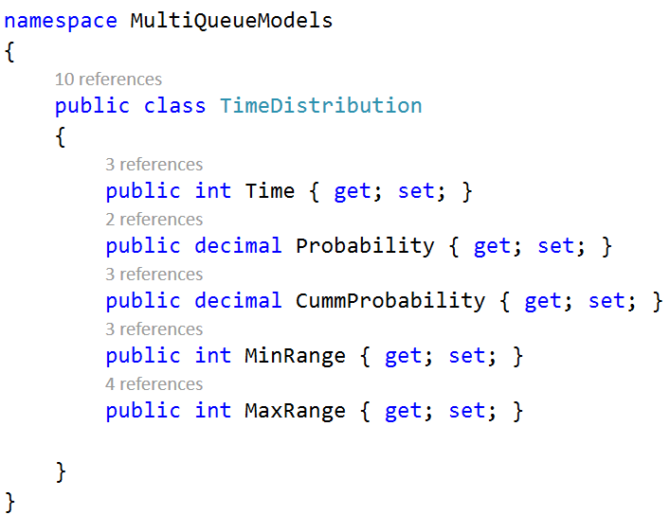

Slide 38
System Output - Performance Measures Per Server
Measure servers performance by calculating the following variables:
Notes:
Total number of customers : number of customers that have entered the server
Total time customers waited in queue : the sum of delay time of the customers that entered the server
Number of customers who waited: number of customers that have entered the server and having delay time > 0

Slide 39
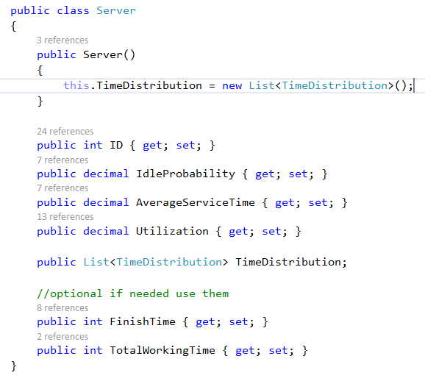

Slide 40
Multi-channel Queue - Sample Output

Slide 41
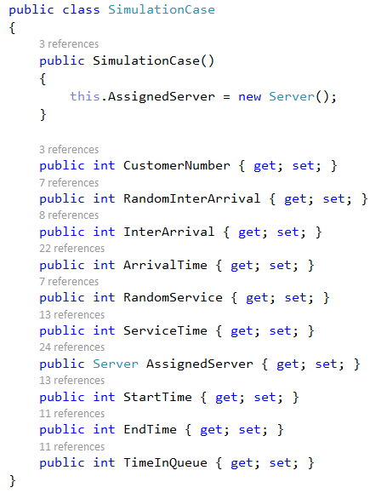

Slide 42
System Output - Performance Measures
Measure system performance by calculating the following variables:
Maximum queue length during simulation runtime.
Notes:
Total number of customers : number of customers that have entered the server
Total time customers waited in queue : the sum of delay time of the customers that entered the server
Number of customers who waited: number of customers that have entered the server and having delay time > 0

Slide 43
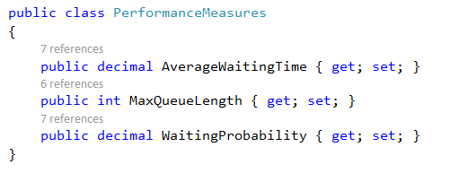

Slide 44
Multi-channel Queue - System Input
Inter-arrival time distribution
Number of servers
Service time distribution for each server
Server Selection method (priority, random, least utilization[BONUS])
Stopping Condition
Maximum Number of customers
Simulation end time

Slide 45
Multi-channel Queue - System Output
Results table including these columns:
Customer No
Random Digit for inter-arrival time
Inter-arrival time
Arrival time (Clock Time)
Random Digit for service duration
Service duration
Server Index
Time Service Begins
Time Service Ends (Departure)
total delay time for this customer (Time in queue)
N.B: Assume Server 1 has higher priority

Slide 46
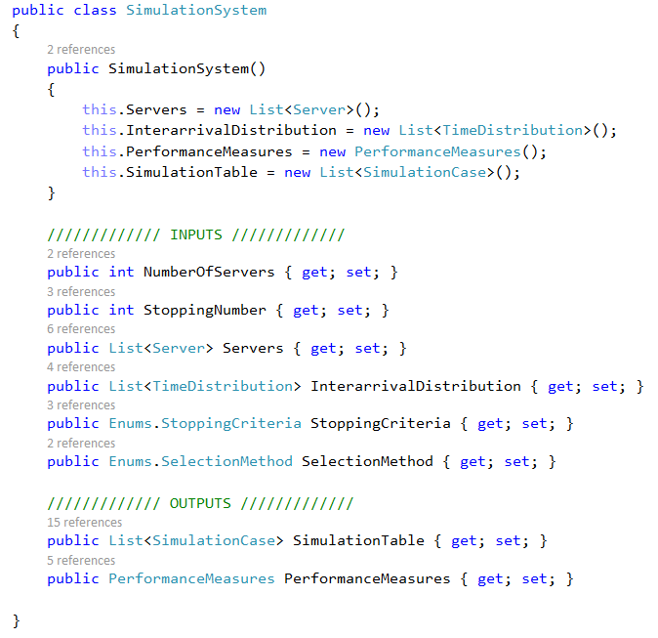

Slide 47
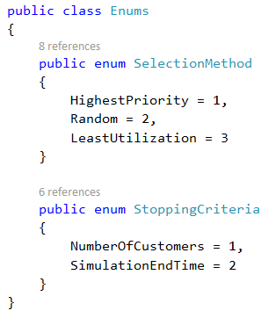

Slide 48
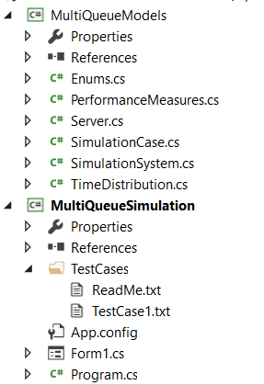
Model Project
Layer where project entities are defined
Windows Form Project
Main project where forms are created to input/output data

Slide 49
Template Walkthrough
You are committed to use the provided template in C#.
You can add constructor if needed but don’t override the default one.
You are provided with only one testcase.
You are given a testcase to run that will provide with a message
Success message if your code runs correctly.
Error message describing the failed part.
Running using testcases
Your system object

Slide 50
Task (1) Delivery Rules
Task support will be held next week during regular lab time in the same lab location.
Task delivery after two weeks
Every team will be assigned a time slot for the task delivery. Teams should commit to their assigned time slot
Any delay will not be accepted
Cheating Policy
First Incident: -10% from the yearwork grades
Second Incident: -50% from the yearwork grades
Third Incident: -100% from the yearwork grades
Notes:
Task delivery time will be sent

